Slide 1
Personas, Scenarios, User Stories and Feature Identification
Management of Software Systems – Requirement Analysis and Design

Slide 2
Software Products
There are three factors that drive the design of software products
Business and consumer needs that are not met by current products
Dissatisfaction with existing business or consumer software products
Changes in technology that make completely new types of product possible
In the early stage of product development, you are trying to understand, what product features would be useful to users, and what they like and dislike about the products that they use.

Slide 3
Software Features
A feature is a fragment of functionality such as a ‘print’ feature, a ‘change background feature’, a ‘new document’ feature and so on.
Before you start programming a product, you should aim to create a list of features to be included in your product.
The feature list should be your starting point for product design and development.

Slide 4
User Understanding
It makes sense in any product development to spend time trying to understand the potential users and customers of your product.
A range of techniques have been developed for understanding the ways that people work and use software.
These include user interviews, surveys, ethnography and task analysis.
Some of these techniques are expensive and unrealistic for small companies.
Informal user analysis and discussions, which simply involve asking users about their work, the software that they use, and its strengths and weaknesses are inexpensive and very valuable.

Slide 5
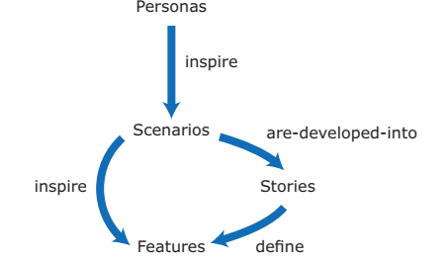
From personas to features
A way of representing users
Natural language descriptions of a user interacting with a software product
Natural language descriptions of something that is needed or wanted by users
Fragments of product functionality

Slide 6
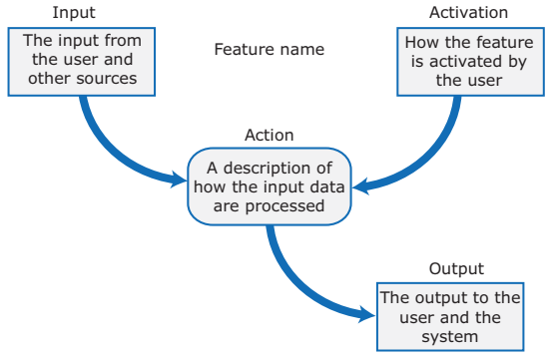
Feature description

Slide 7
Feature description

Slide 8
Personas
You need to have an understanding of your potential users to design features that they are likely to find useful and to design a user interface that is suited to them.
Personas are ‘imagined users’ where you create a character portrait of a type of user that you think might use your product.
For example, if your product is aimed at managing appointments for dentists, you might create a dentist persona, a receptionist persona and a patient persona.
Personas of different types of user help you imagine what these users may want to do with your software and how it might be used. They help you envisage difficulties that they might have in understanding and using product features.

Slide 9
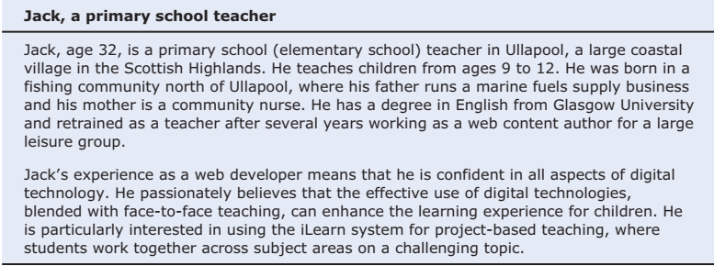
Persona for a primary school teacher

Slide 10
Persona descriptions
A persona should ‘paint a picture’ of a type of product user. They should be relatively short and easy-to-read.
You should describe their background and why they might want to use your product.
You should also say something about their educational background and technical skills.
These help you assess whether or not a software feature is likely to be useful, understandable and usable by typical product users

Slide 11
Persona descriptions

Slide 12
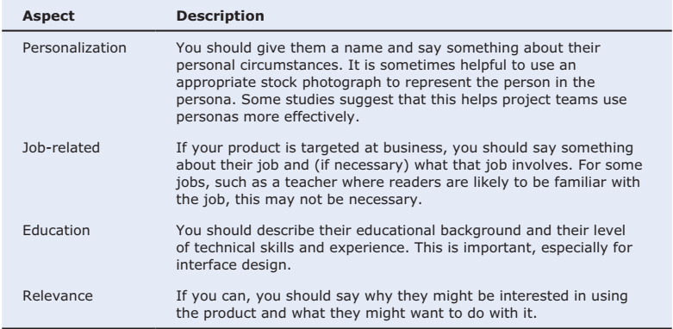
Aspects of a personal description

Slide 13
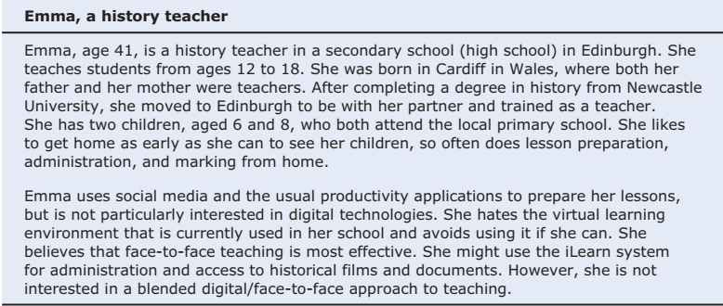
Persona for a history teacher

Slide 14
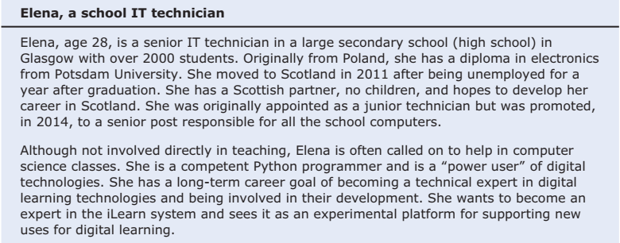
Persona for an IT Technician

Slide 15
Persona benefits
The main benefit of personas is that they help you and other development team members empathize with potential users of the software.
Personas help because they are a tool that allows developers to ‘step into the user’s shoes’.
Instead of thinking about what you would do in a particular situation, you can imagine how a persona would behave and react.
Personas can help you check your ideas to make sure that you are not including product features that aren’t really needed.
They help you to avoid making unwarranted assumptions, based on your own knowledge, and designing an over-complicated or irrelevant product.

Slide 16
Deriving personas
Personas should be based on an understanding of the potential product users, their jobs, their background and their aspirations.
You should study and survey potential users to understand what they want and how they might use the product.
From this data, you can then abstract the essential information about the different types of product user and use this as a basis for creating personas.
Personas that are developed on the basis of limited user information are called proto-personas.
Proto-personas may be created as a collective team exercise using whatever information is available about potential product users. They can never be as accurate as personas developed from detailed user studies, but they are better than nothing.

Slide 17
Scenarios
A scenario is a narrative that describes how a user, or a group of users, might use your system.
There is no need to include everything in a scenario – the scenario isn’t a system specification.
It is simply a description of a situation where a user is using your product’s features to do something that they want to do.
Scenario descriptions may vary in length from two to three paragraphs up to a page of text.

Slide 18
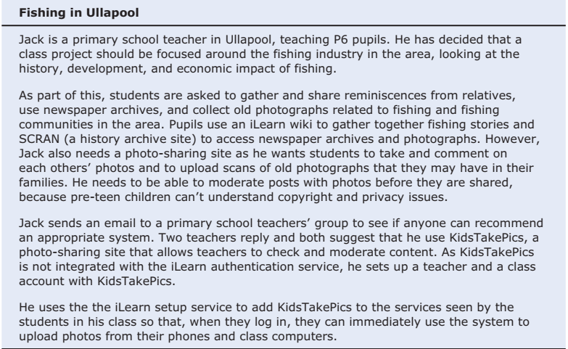
Jack’s scenario: using the iLearn system for class projects

Slide 19
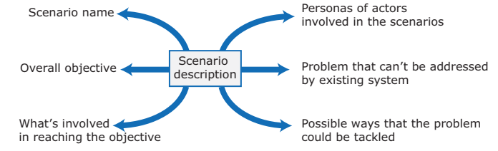
Elements of a scenario description

Slide 20
Scenario Elements
A brief statement of the overall objective.
In Jack’s scenario, this is to support a class project on the fishing industry.
References to the personas involved (Jack) so that you can get information about the capabilities and motivation of that user.
Information about what is involved in doing the activity. For example, in Jack’s scenario this involves gathering reminiscences from relatives, accessing newspaper archives, etc.
An explanation of problems that can’t be readily addressed using the existing system.
Young children don’t understand issues such as copyright and privacy, so photo sharing requires a site that a teacher can moderate to make sure that published images are legal and acceptable.
A description of one way that the identified problem might be addressed.
In Jack’s scenario, the preferred approach is to use an external tool designed for school students.

Slide 21
Emma’s Scenario
. Emma’s scenario is different from Jack’s scenario in that it describes a common and well-understood process rather than something new.
Emma is an e-learning sceptic and she is not interested in innovative applications. She wants a system that will make her life easier and reduce the amount of routine administration that she has to do.
The scenario discusses how parts of the process (setting up an email group and web page) are automated by the iLearn system.

Slide 22
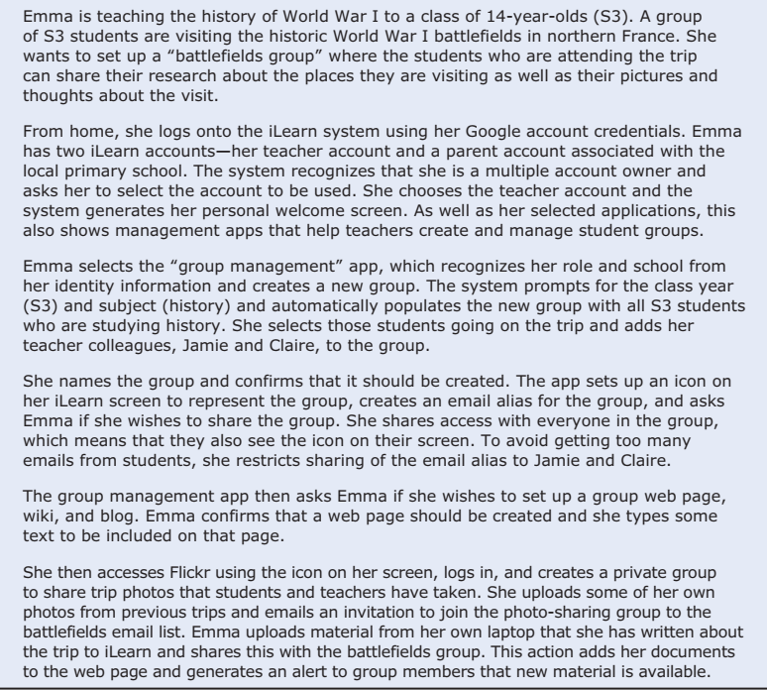
Emma’s scenario: using iLearn for administration

Slide 23
Writing scenarios
Scenarios should always be written from the user’s perspective and based on identified personas or real users.
Your starting point for scenario writing should be the personas that you have created. You should normally try to imagine several scenarios from each persona.
Ideally, scenarios should be general and should not include implementation information.
However, describing an implementation is often the easiest way to explain how a task is done.
It is important to ensure that you have coverage of all of the potential user roles when describing a system.

Slide 24
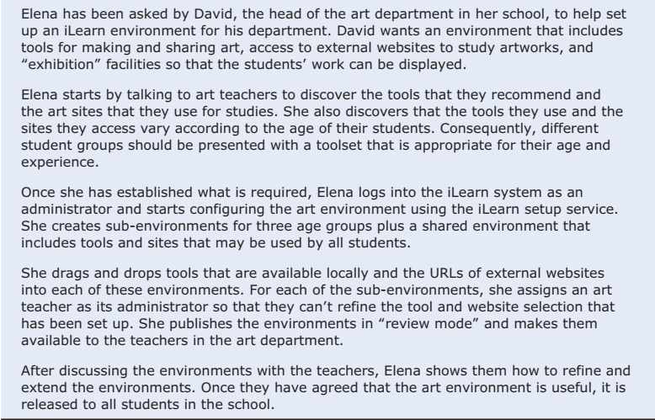
Elena’s scenario: configuring the iLearn System

Slide 25
User involvement
It is easy for anyone to read and understand scenarios, so it is possible to get users involved in their development.
The best approach is to develop an imaginary scenario based on our understanding of how the system might be used then ask users to explain what you have got wrong.
They might ask about things they did not understand and suggest how the scenario could be extended and made more realistic.
Our experience was that users are not good at writing scenarios.
The scenarios that they created were based on how they worked at the moment. They were far too detailed and the users couldn’t easily generalize their experience.

Slide 26
User stories
Scenarios are high-level stories of system use. They should describe a sequence of interactions with the system but should not include details of these interactions.
User stories are finer-grain narratives that set out in a more detailed and structured way a single thing that a user wants from a software system.
As an author, I need a way to organize the book that I’m writing into chapters and sections.
This story reflects what has become the standard format of a user story:
As a <role>, I <want | need> to <do something>
As a teacher, I want to tell all members of my group when new information is available
A variant of this standard format adds a justification for the action:
As a <role> I <want | need> to <do something> so that <reason>
As a teacher, I need to be able to report who is attending a class trip so that the school maintains the required health and safety records.

Slide 27
User stories in planning
An important use of user stories is in planning.
Many users of the Scrum method represent the product backlog as a set of user stories.
User stories should focus on a clearly defined system feature or aspect of a feature that can be implemented within a single sprint.
If the story is about a more complex feature that might take several sprints to implement, then it is called an epic.
As a system manager, I need a way to backup the system and restore either individual applications, files, directories or the whole system.
There is a lot of functionality associated with this user story. For implementation, it should be broken down into simpler stories with each story focusing on a single aspect of the backup system.

Slide 28
User stories from Emma’s scenario

Slide 29
Feature description using user stories
Stories can be used to describe features in your product that should be implemented.
Each feature can have a set of associated stories that describe how that feature is used

Slide 30
User stories describing the group’s features

Slide 31
Stories and scenarios
As you can express all of the functionality described in a scenario as user stories, do you really need scenarios?’
Scenarios are more natural and are helpful for the following reasons:
Scenarios read more naturally because they describe what a user of a system is actually doing with that system. People often find it easier to relate to this specific information rather than the statement of wants or needs set out in a set of user stories.
If you are interviewing real users or are checking a scenario with real users, they don’t talk in the stylized way that is used in user stories. People relate better to the more natural narrative in scenarios.
Scenarios often provide more context - information about what the user is trying to do and their normal ways of working. You can do this in user stories, but it means that they are no longer simple statements about the use of a system feature.

Slide 32
Feature identification
Your aim in the initial stage of product design should be to create a list of features that define your product.
A feature is a way of allowing users to access and use your product’s functionality so the feature list defines the overall functionality of the system.
Features should be independent, coherent and relevant:
Independence Features should not depend on how other system features are implemented and should not be affected by the order of activation of other features.
Coherence Features should be linked to a single item of functionality. They should not do more than one thing and they should never have side-effects.
Relevance Features should reflect the way that users normally carry out some task. They should not provide obscure functionality that is hardly ever required.

Slide 33
Feature design

Slide 34
Knowledge required for feature design
User knowledge
Product knowledge
Domain knowledge
Technology knowledge
You can use user scenarios and user stories to inform the team of what users want and how they might use it as the software features.
You may have experience of existing products or decide to research what these products do as part of your development process. Sometimes, your features have to replicate existing features in these products because they provide fundamental functionality that is always required.
This is knowledge of the domain or work area(e.g. finance, event booking) that your product aims to support. By understanding the domain, you can think of new innovative ways of helping users do what they want to do.
New products often emerge to take advantage of technological developments since their competitors were launched. If you understand the latest technology, you can design features to make use of it.

Slide 35
Factors in feature set design

Slide 36
Feature trade-offs
Simplicity and functionality
You need to find a balance between providing a simple, easy-to-use system and including enough functionality to attract users with a variety of needs.
Familiarity and novelty
Users prefer that new software should support the familiar everyday tasks that are part of their work or life. To encourage them to adopt your system, you need to find a balance between familiar features and new features that convince users that your product can do more than its competitors.
Automation and control
Some users like automation, where the software does things for them. Others prefer to have control. You have to think carefully about what can be automated, how it is automated and how users can configure the automation so that the system can be tailored to their preferences.

Slide 37
Feature creep
Feature creep occurs when new features are added in response to user requests without considering whether or not these features are generally useful or whether they can be implemented in some other way.
Too many features make products hard to use and understand
There are three reasons why feature creep occurs:
Product managers are reluctant to say ‘no’ when users ask for specific features.
Developers try to match features in competing products.
The product includes features to support both inexperienced and experienced users.

Slide 38
Avoiding feature creep

Slide 39
Feature derivation
Features can be identified directly from the product vision or from scenarios.
You can highlight phrases in narrative description to identify features to be included in the software.
You should think about the features needed to support user actions, identified by active verbs, such as use and choose.

Slide 40
The iLearn System Vision
FOR teachers and educators WHO need a way to help students use web-based learning resources and applications, THE iLearn system is an open learning environment THAT allows the set of resources used by classes and students to be easily configured for these students and classes by teachers themselves.
UNLIKE Virtual Learning Environments, such as Moodle, the focus of iLearn is the learning process itself, rather than the administration and management of materials, assessments and coursework. OUR product enables teachers to create subject and age-specific environments for their students using any web-based resources, such as videos, simulations and written materials that are appropriate

Slide 41
Features from the product vision
A feature that allows users to access and use existing web-based resources;
A feature that allows the system to exist in multiple different instantiations;
A feature that allows user configuration of the system to create a specific instantiation.

Slide 42
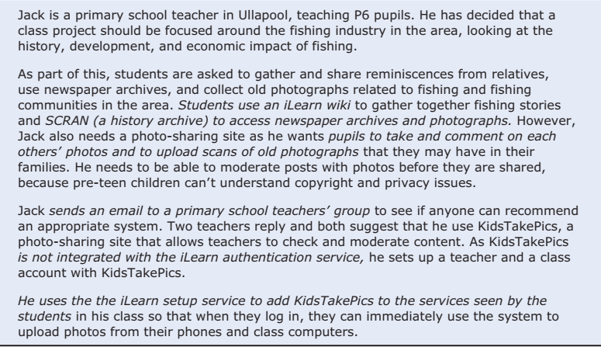
Jack’s scenario with highligted phrases

Slide 43
Features from Jack’s scenario
A wiki for group writing.
Access to the SCRAN history archive. This is a shared national resource that provides access to historical newspaper and magazine articles for schools and universities.
Features to set up and access an email group.
A feature to integrate applications with the iLearn authentication service

Slide 44
The feature list
The output of the feature identification process should be a list of features that you use for designing and implementing your product.
There is no need to go into a lot of detail about the features at this stage. You add detail when you are implementing the feature.
You can describe features using a standard input-action-output template by using structured narrative descriptions or by a set of user stories.

Slide 45
iLearn authentication feature

Slide 46
Feature description using user stories
Description
As a system manager, I want to set up sub-environments that include a subset of services that are included in another environment.
As a system manager, I want to assign administrators to created environments.
As a system manager, I want to limit the rights of environment administrators so that they cannot accidentally or deliberately disrupt the operation of key services.
As a teacher, I want to be able to add services that are not integrated with the iLearn authentication system.
Constraints
Comments
As a system manager, I want to create and configure an iLearn environment by adding and removing services to/from that environment so that I can create environments for specific purposes.
The use of some tools may be limited for license reasons so there may be a need to access license management tools during configuration.
Based on Elena’s and Jack’s scenarios

Slide 47
Innovation and feature identification
Scenarios and user stories should always be your starting point for identifying product features.
Scenarios tell you how users work at the moment. They don’t show how they might change their way of working if they had the right software to support them.
Stories and scenarios are ‘tools for thinking’ and they help you gain an understanding of how your software might be used. You can identify a feature set from stories and scenarios.
User research, on its own, rarely helps you innovate and invent new ways of working.
You should also think creatively about alternative or additional features that help users to work more efficiently or to do things differently.

Slide 48
Summary
A software product feature is a fragment of functionality that implements something that a user may need or want when using the product.
The first stage of product development is to identify the list of product features in which you identify each feature and give a brief description of its functionality.
Personas are ‘imagined users’ where you create a character portrait of a type of user that you think might use your product.
A persona description should ‘paint a picture’ of a typical product user. It should describe their educational background, technology experience and why they might want to use your product.
A scenario is a narrative that describes a situation where a user is accessing product features to do something that they want to do.
Contd……………

Slide 49
Summary
Scenarios should always be written from the user’s perspective and should be based on identified personas or real users.
User stories are finer-grain narratives that set out, in a structured way, something that a user wants from a software system.
User stories may be used as a way of extending and adding detail to a scenario or as part of the description of system features.
The key influences in feature identification and design are user research, domain knowledge, product knowledge, and technology knowledge.
You can identify features from scenarios and stories by highlighting user actions in these narratives and thinking about the features that you need to support these actions.

Slide 50
